Slide 1
Architecture design
Siddharth Agarwal
Shreyansh
Garvit Gupta
Priet Ukani

Slide 2
AGENDA
Cloud Models
Timeline

Slide 3
INTRODUCTION
We plan to figure out a cost effective, easy to use cloud service provider for deploying the ML model and provide an approximate timeline of the project.

Slide 4
Cloud Models

Slide 5
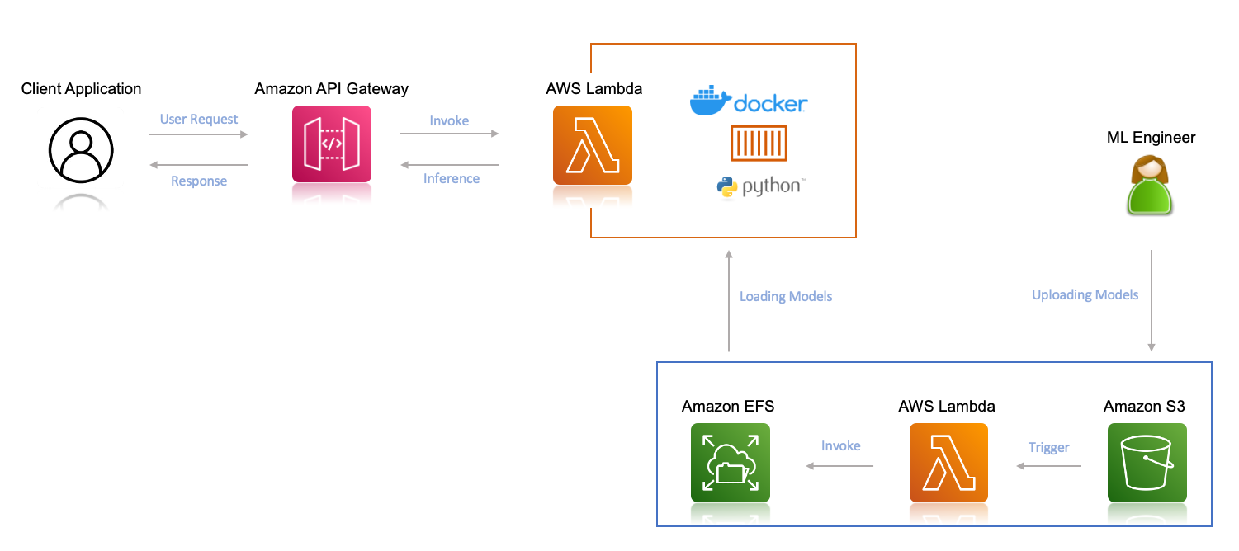
Amazon LAMBDA + S3 + EFS

Slide 6
Amazon LAMBDA + S3 + EFS
Simple and cost-effective. Charges will be applicable as per inferences.
Due to the complexity of deploying a pre-trained model on Sagemaker and its high cost, we would prefer to deploy on lambda + S3 now, and when monitoring and more scaling is required, we can add Sagemaker to our architecture.
Pros: Simple & best suitable for our current situation, cost-efficient (as per inference) & easy to handle. (We can switch to Sagemaker whenever required)
Cons: Less automatic MLOps functionalities available, also less scalable than sagemaker. Manual handling of the retraining process

Slide 7
Google Cloud function
Step 1- Training the model on your local machine.
Step 2- Creating a new Google Cloud Project.
Step 3- Storing the pre-trained model in a Google Cloud Storage.
Step 4- Writing the Google Cloud Function for deployment
Quite similar to lambda function architecture.
Pros: simple and easy to use like lambda with S3 & cost efficient
Cons: Will need manual implementation to retrain model.
Others Cloud Services by Google: EC2, Google App engine, Vertex AI etc.

Slide 8
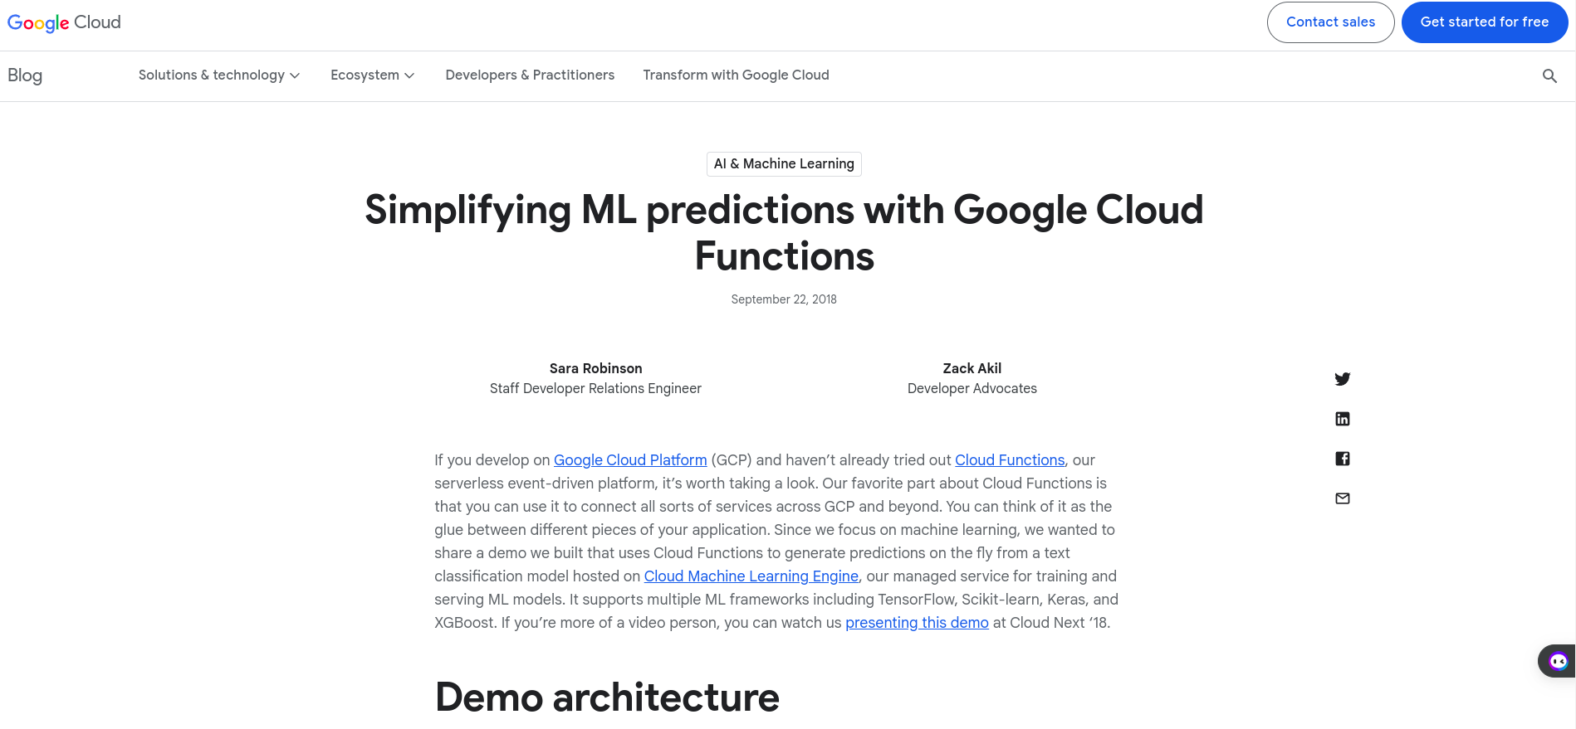
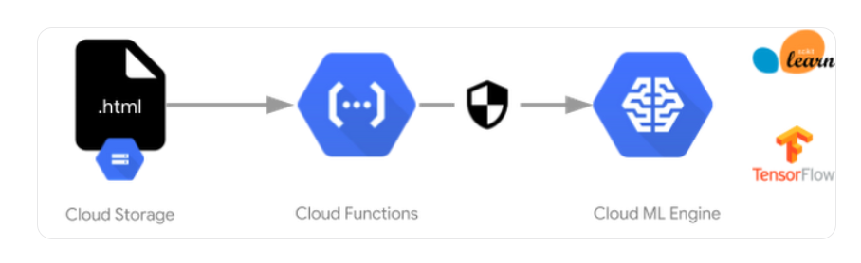
Webpage

Slide 9
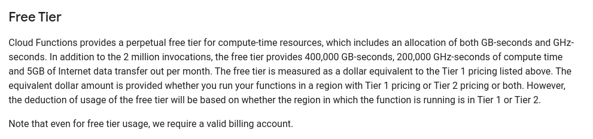
GOOGLE CLOUD FUNCTION FREE TIER
Webpage
Monthly 2 million requests are free.
400,000 GB-seconds and 200,000 GHz-Seconds computation is free

Slide 10
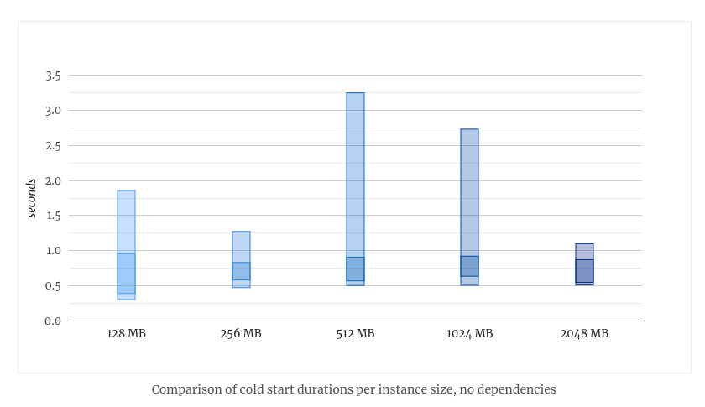
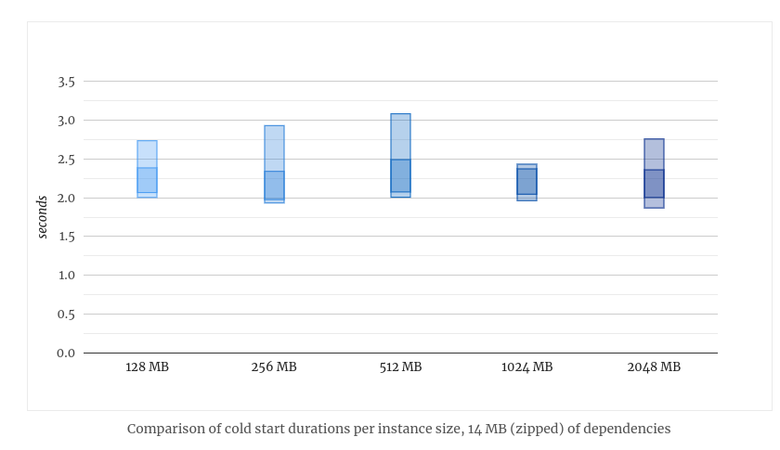
GOOGLE CLOUD FUNCTION COLD START
Webpage
Cold start with different instance sizes with 0 dependencies to be installed
Cold start with 14 MBs of dependencies
Suggestive Measure- We can have minimum number of instances always running (adds up to cost).
Or a minimalistic function running on extra instances to reduce cold start.

Slide 11
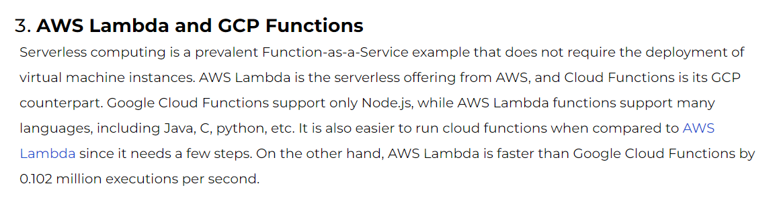
Google Cloud function VS AWS LAMBDA
Link
AWS Lambda is slightly faster
Lambda supports more languages (though Python is there in both, which is required mostly)
Lambda is quite complex to setup

Slide 12
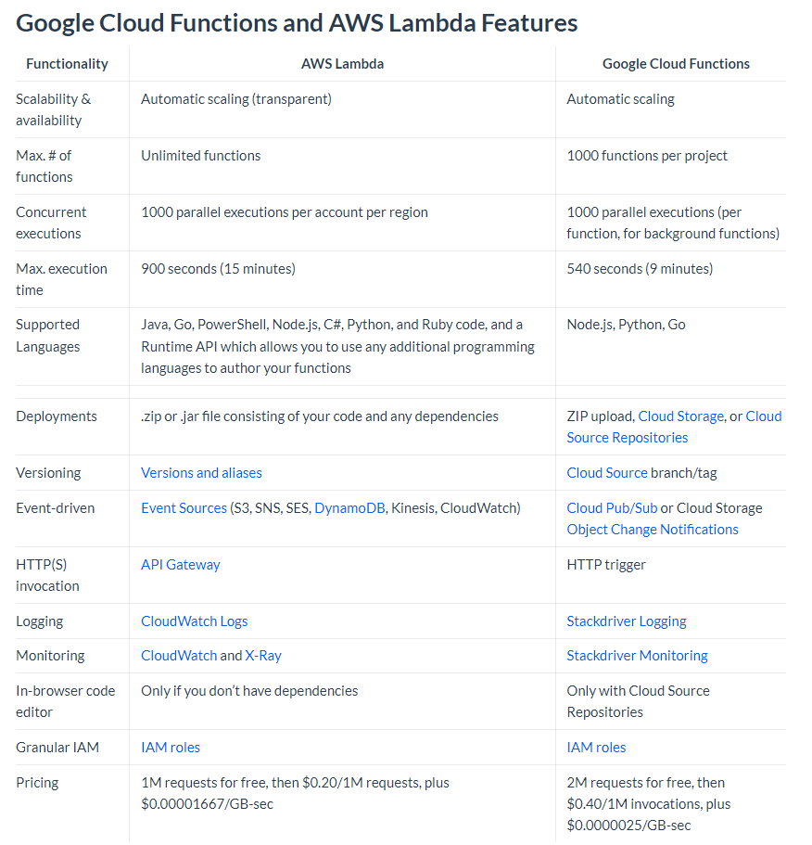
Google Cloud function VS AWS LAMBDA
Link
AWS is better wrt pricing

Slide 13
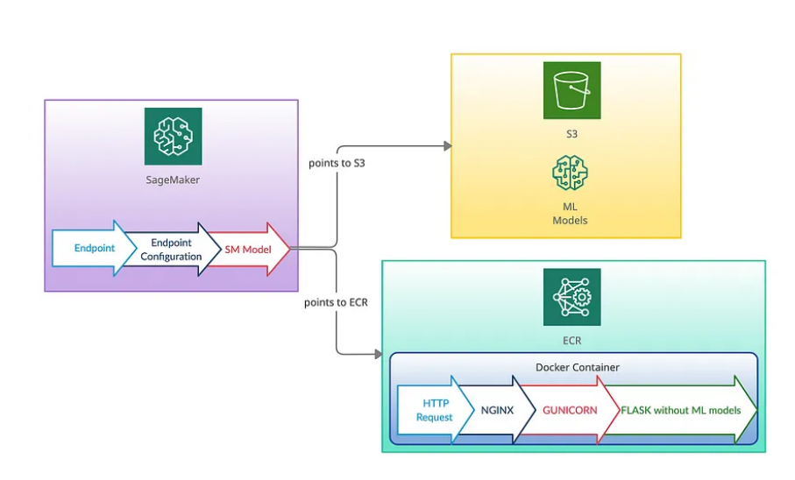
AMAZON Sagemaker
Amazon Sagemaker with other services of AWS like S3 Buckets, AWS ECR, AWS lambda & api Gateway.

Slide 14
AMAZON SAGEMAKER
Amazon SageMaker is a fully managed machine learning service. It helps data scientists and developers to prepare, build, train, and deploy high-quality machine learning (ML) models quickly.
It provides an integrated Jupyter authoring notebook instance to easily access your data sources for exploration and analysis.
Pros: automatic MLOps functionalities, Make monitoring & analysis of ML models easy (but we don’t have to delve into model monitoring right now, we have to focus on how to provide users access of the service model).
Cons: Higher cost than Lambda function architecture & a little bit complicated while deploying pretrained model on sagemaker endpoint instead of building and training model on sagemaker and then deploying it on the endpoint.

Slide 15
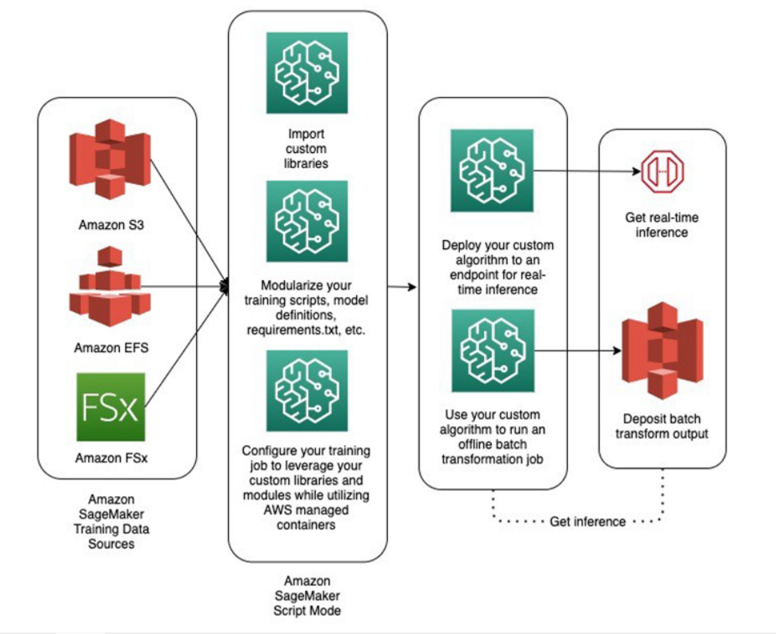
Amazon Sagemaker script mode

Slide 16
AMAZON SAGEMAKER SCRIPT MODE
Script mode enables you to write custom training and inference code while still utilizing common ML framework containers maintained by AWS. Script mode is easy to use and flexible.
Pros: We can customize libraries we want to use, we can customize code to train-retrain model & we can also customize inference code by giving our own scripts. (quite similar to Sagemaker + S3 + ECR).
Cons: Since Sagemaker is involved so all the previous cons are applicable here too.

Slide 17
Other alternatives
Other alternatives are Amazon EC2, Google App Engine, Vertex AI etc.
Google App Engine (GAE) is a platform for building and hosting scalable web applications and mobile backends. It's a fully managed, serverless platform that allows developers to build applications in any programming language.
Vertex AI is analogous to Sagemaker in AWS.
Amazon Elastic Compute Cloud (Amazon EC2) is a web service that provides secure, scalable computing capacity in the Amazon Web Services (AWS) Cloud

Slide 18
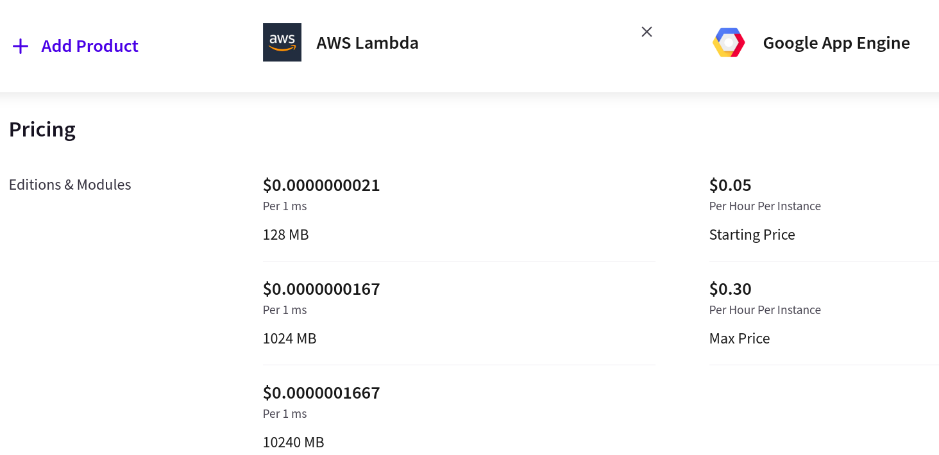
Google App ENGINE(GAE)
Google App Engine is a fully managed Platform as a Service (PaaS) platform. This means that Google takes care of all of the underlying infrastructure and management tasks. It essentially operates 24/7 and dynamically scales up or down container instances based on traffic.
In terms of programming language , scaling , deployment options and integration with other services both are the same.
Main Difference is in the pricing model: AWS Lambda pricing is based on the number of requests and the amount of compute time consumed by those requests, while Google App Engine pricing is based on the number of instances and the amount of network traffic used by the application.
Pricing Comparison: price
Lambda function is more budget friendly and offers more control on infrastructure like instance type selection , scaling , storage options whereas google app engine automatically scales workload , not much control over server infrastructure.

Slide 19
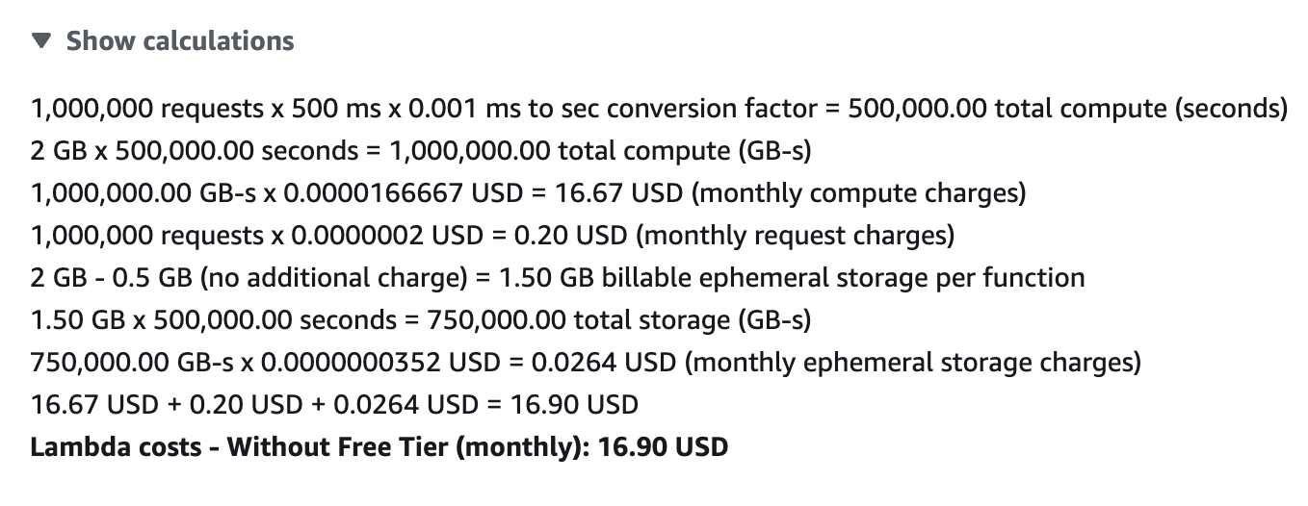
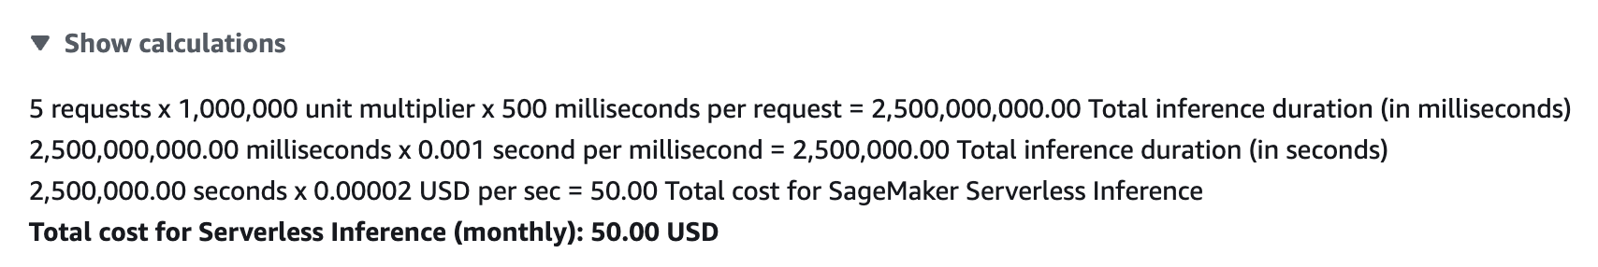
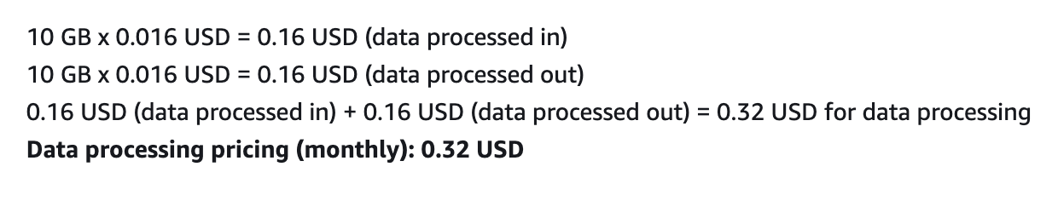

Costing
AWS Lambda (Without Free Tier)
AWS SageMaker

Slide 20
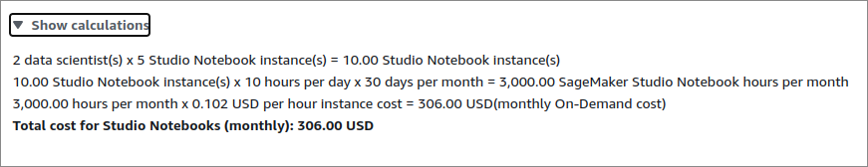
Sagemaker PRicing (notebook)

Slide 21
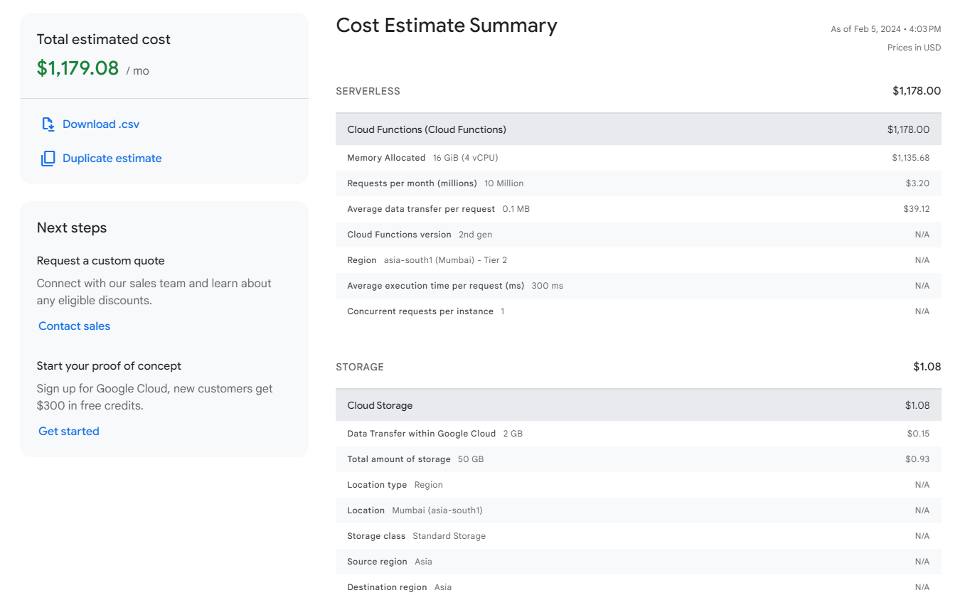
Costing
GCP
COST
ESTIMATE
(1 concurrent request)
https://cloud.google.com/products/calculator/estimate-preview/18c96da0-1fd0-4637-9194-64196783bbe7?hl=en

Slide 22
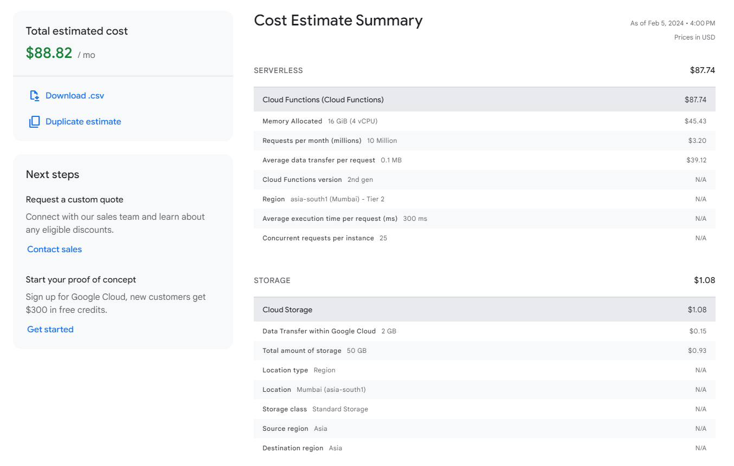
Costing
GCP
COST
ESTIMATE (25 concurrent requests)
https://cloud.google.com/products/calculator/estimate-preview/271ada9b-8954-4d5d-a612-e5d42f8e1177?hl=en

Slide 23
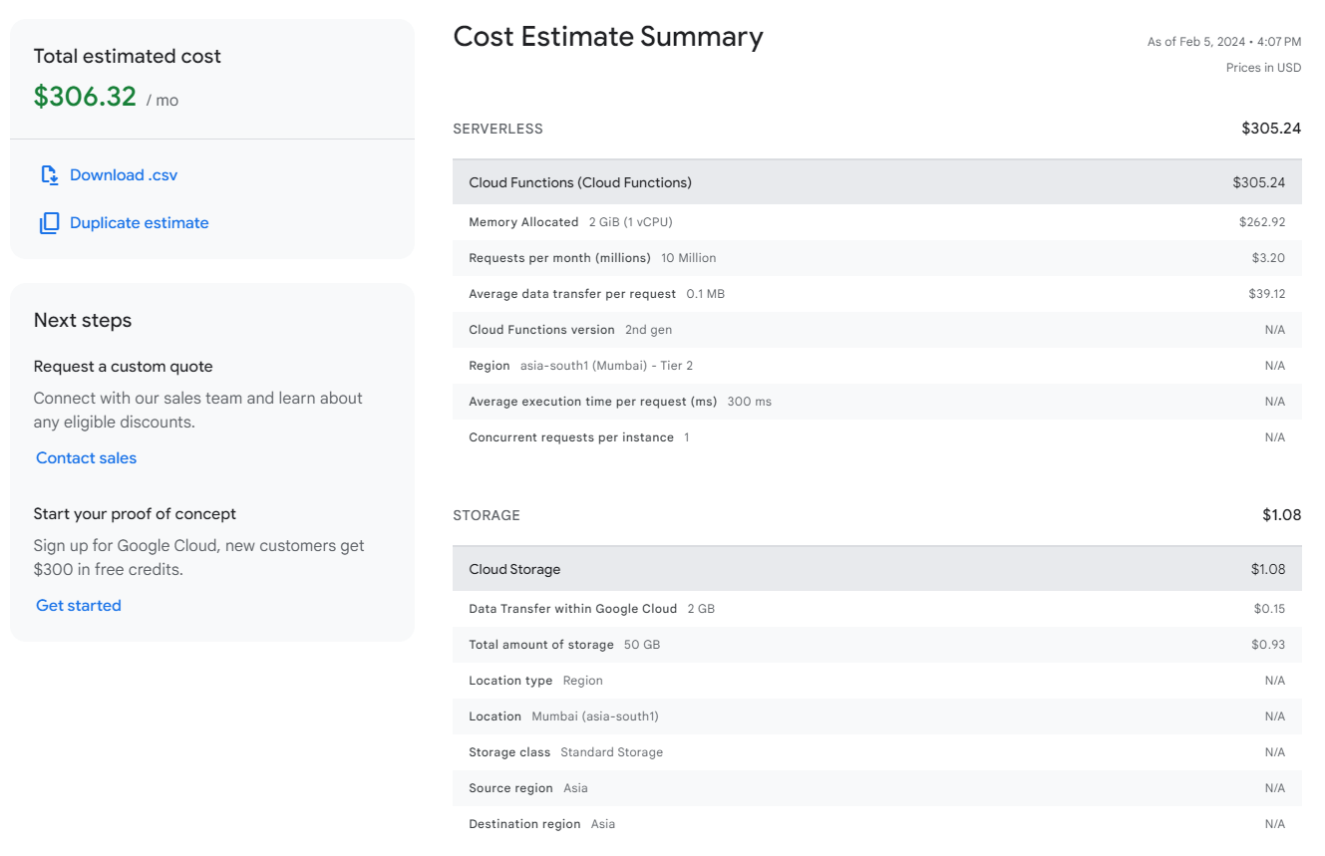
Costing
GCP
COST
ESTIMATE (1 concurrent request)
https://cloud.google.com/products/calculator/estimate-preview/2f0b6e94-8508-482c-920e-72497ba7fc07?hl=en
More realistic 2GB WITH 1 CONCURRENT REQUEST PER INSTANCE.
Increasing minimum number of instances to 1 will help remove cold start latency and cost only increases by 50$ in the above cost estimation

Slide 24
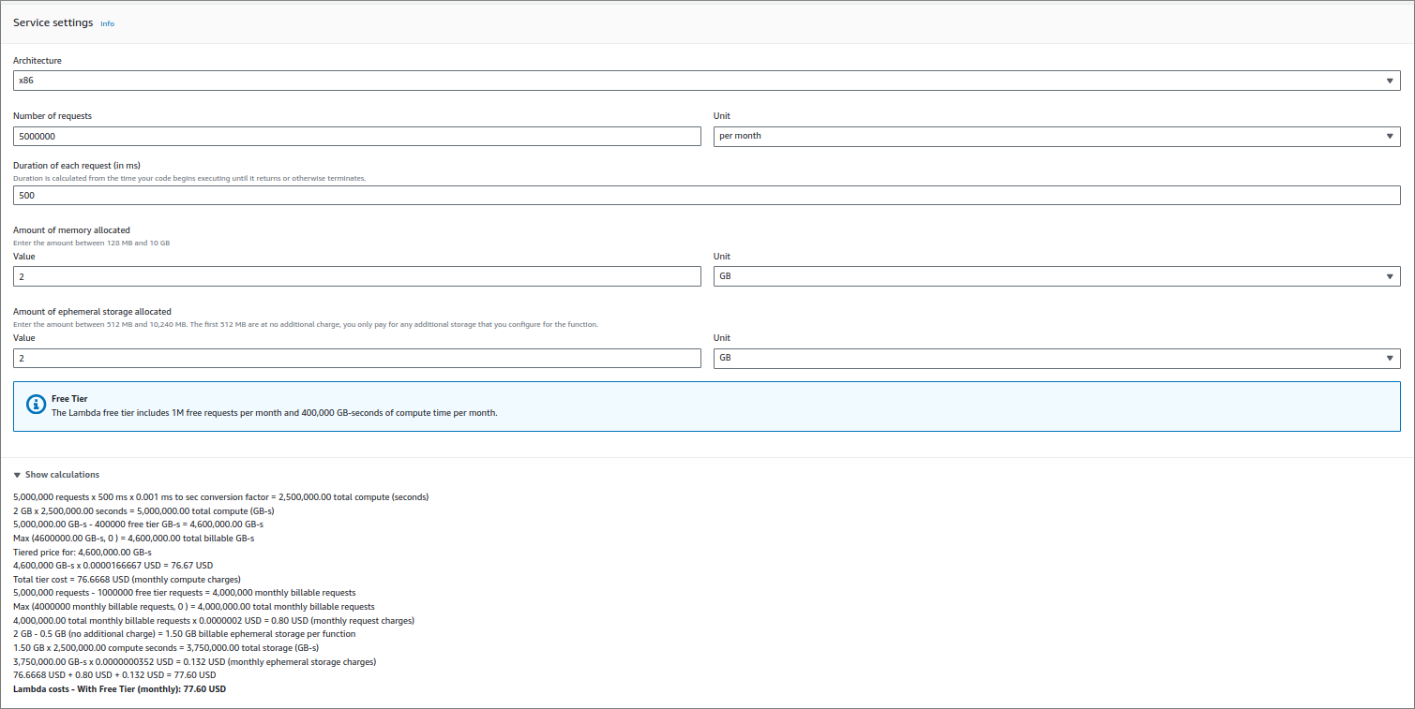
Lambda PRicing (Lambda function )

Slide 25
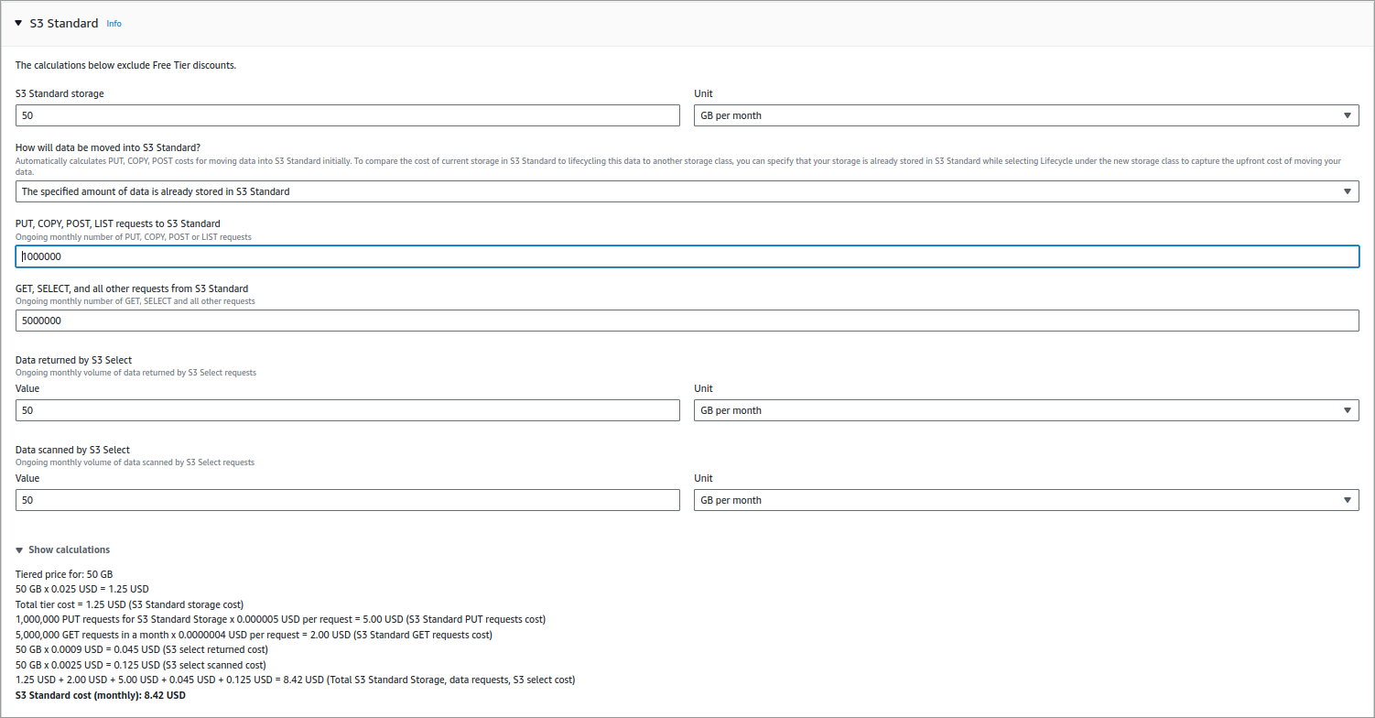
Lambda PRicing (s3 storage)

Slide 26
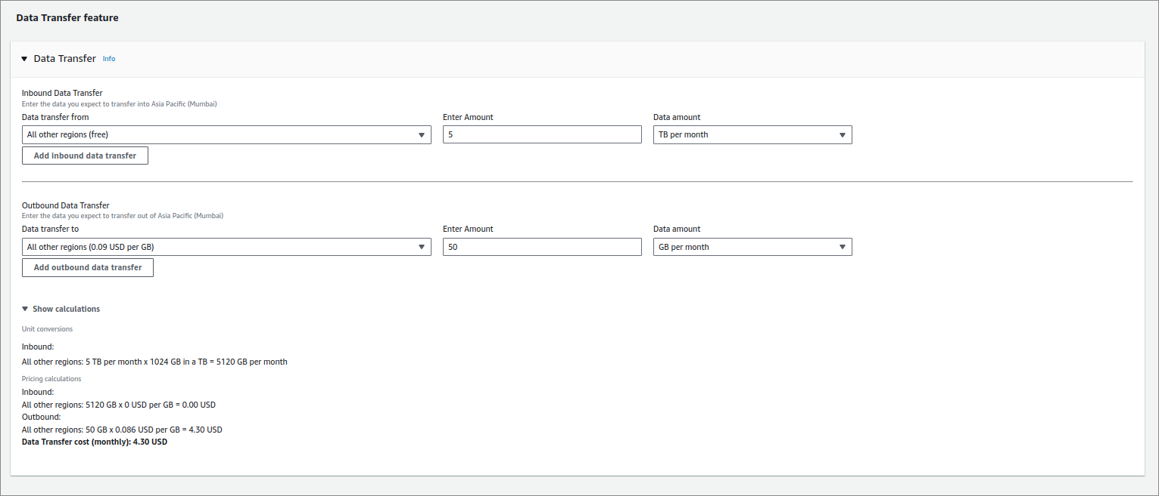
Lambda PRicing (s3 Data transfer)

Slide 27
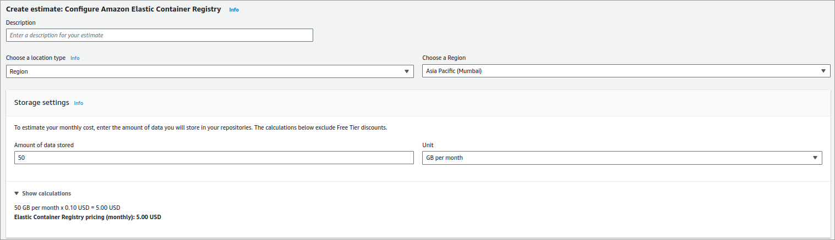
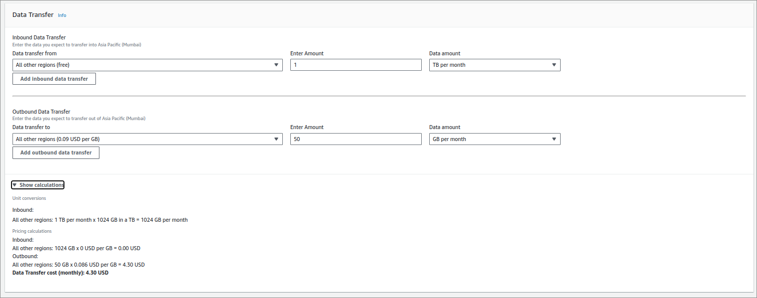
Lambda PRicing (ecr container)

Slide 28
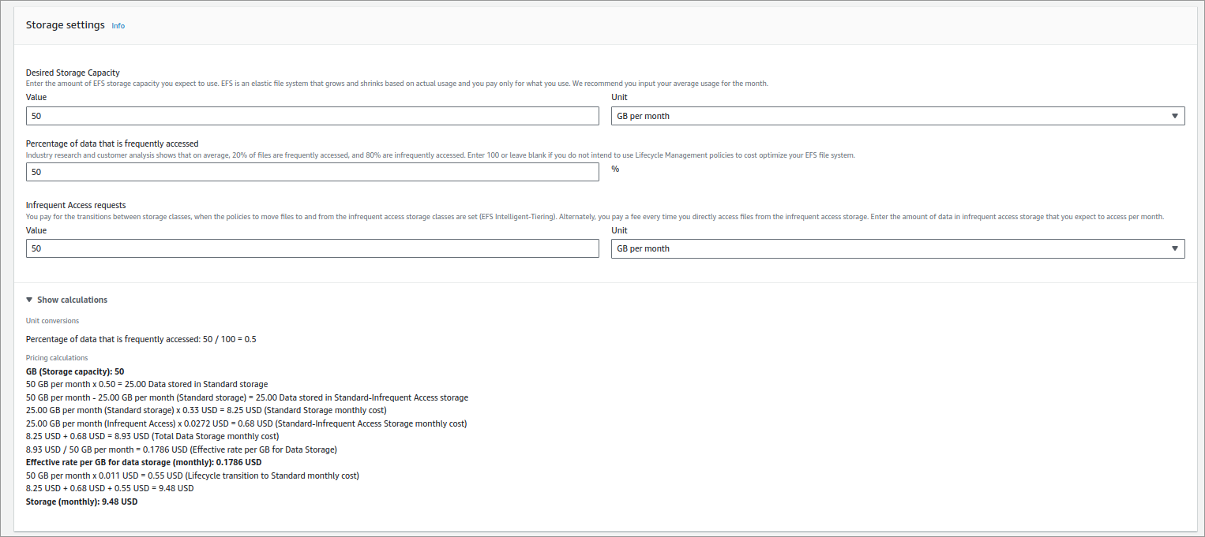
Lambda PRicing (EFS)

Slide 29
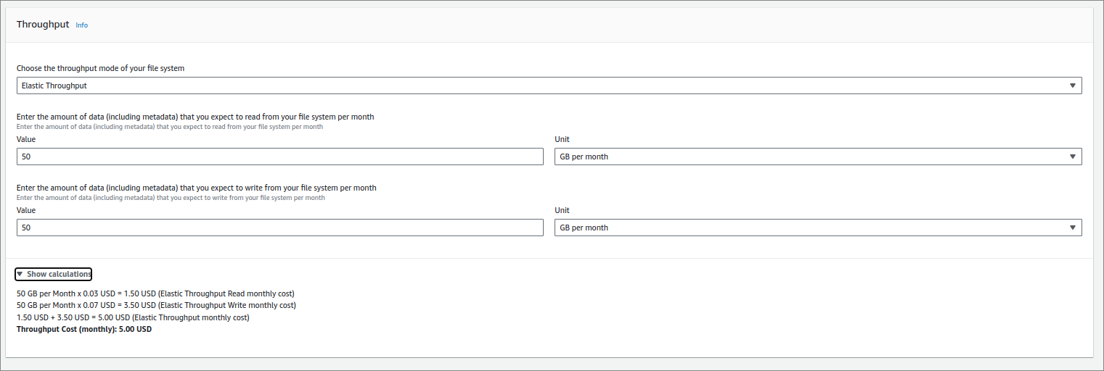
Lambda PRicing (EFS ELASTIC THROUGHPUT)

Slide 30
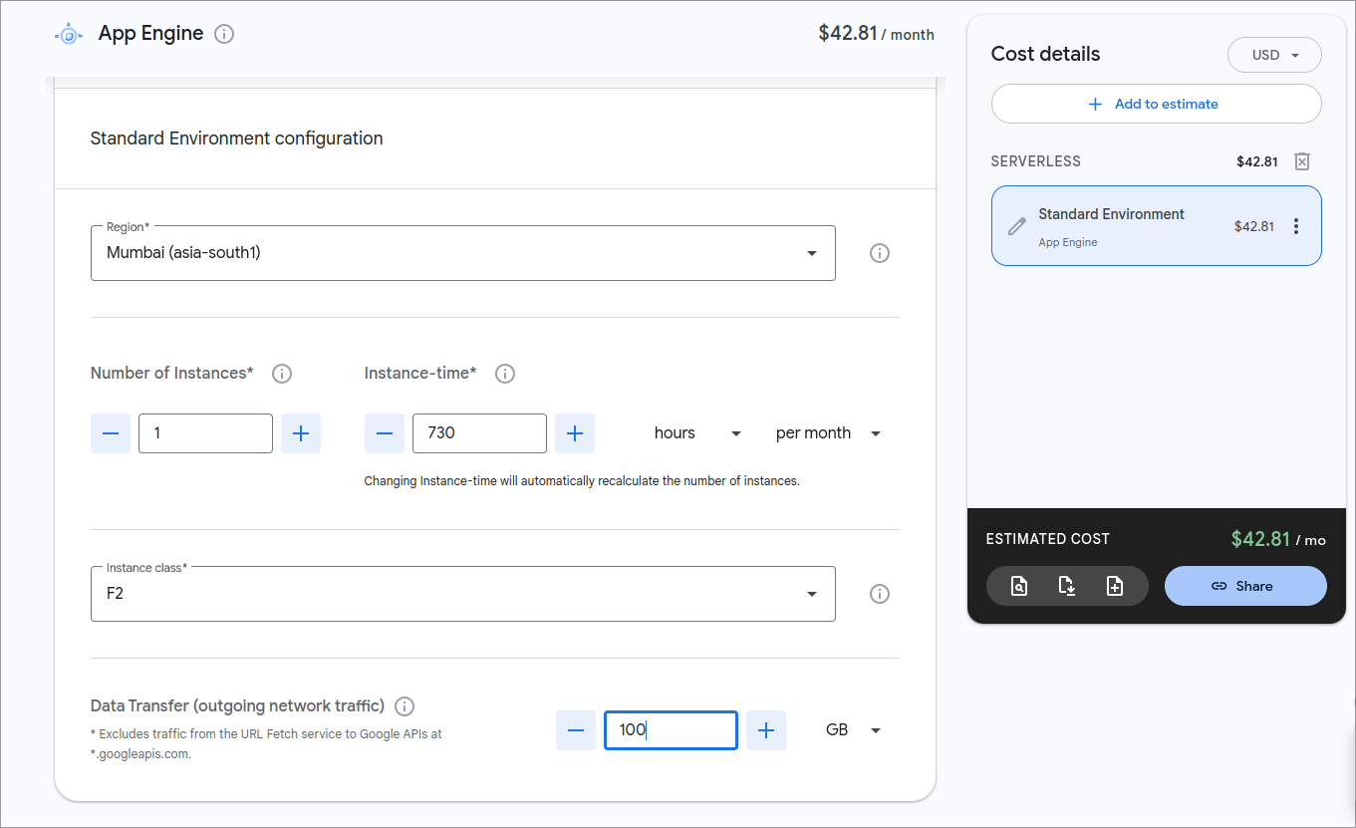
SUGGESTION: APP ENGINE

Slide 31
TIMELINE
Milestone | Due Date | Release | Deliverable?
Draft temporary document for architecture & timeline | 1/2/24 | R1 | Yes
Finalizing architecture | 5/2/24 | R1 | Yes
Making the high level design for extension | 20/2/24 | R1 | Yes
Deciding on tools to use based on design | 23/2/24 | R1 | Yes
Distribution of implementation work | 23/2/24 | R1 | No
Building a primitive version of the app | 5/3/24 | R1 | No
Testing the primitive app for bugs or faults | 10/3/24 | R2 | No
Building the final version of the app | 20/3/24 | R2 | Yes
Reiterations & modifications | 15/4/24 | R2 | Yes
Final extensive testing and fixing | 18/4/24 | R2 | No
Deployment and Final release of the app | 20/4/24 | R2 | Yes

Slide 32
FINAL
 | AWS Lambda | Google Cloud Function
Cost
Computation Power | AWS Lambda is faster than Google Cloud Functions by 0.102 million executions per second. | Slower Compared to AWS Lambda
Storage capacity | No limit. Very cheap | Limit of 32GiB
Possibility of Scheduled Instances | Yes (Through Provisioned Concurrency) | Yes
Flexibility
Team's comments/ thoughts | This service is used by many companies, including Grammarly, Netflix, Facebook, etc. Documentation.

Slide 33
FINAL
 | AWS Lambda | Google Cloud Function
Number of functions | Unlimited Functions | Limits to 1000 functions

Slide 34
Links to refer
https://course19.fast.ai/
https://developer.nvidia.com/blog/machine-learning-in-practice-deploy-an-ml-model-on-google-cloud-platform/
https://medium.com/geekculture/84af8989d065
https://aws.amazon.com/blogs/machine-learning/bring-your-own-model-with-amazon-sagemaker-script-mode/
https://calculator.aws/#/addService (For Cost Estimation)
https://cloud.google.com/products/calculator?hl=en&dl=CiQ5MzExZWE5My1iOGZlLTRkNmItYmRiNC1jM2U3YjRmZGYyZGIQExokNjhCODYzOTUtNDc3RS00N0Y1LTg5OEEtRThEMTlBMENDMTlD (For GCP Cost Estimation)

Slide 35
Links to Trustable references regarding architecture
https://www.appsruntheworld.com/customers-database/purchases/view/grammarly-usa-selects-amazon-sagemaker-for-machine-learning-and-data-science-platform?amp=1 (Grammarly selects sagemaker)
https://aws.amazon.com/sagemaker/customers/ (Grammarly listed as customer at sagemaker's official site)
https://course19.fast.ai/deployment_aws_lambda.html (Fast.ai's documentation for deployment on aws lambda)
https://course19.fast.ai/deployment_amzn_sagemaker.html (Fast.ai's documentation for deployment on sagemaker)
https://www.grammarly.com/blog/engineering/building-flexible-deployment-system-fsharp-fparsec/ (Grammarly using lambda function and talks abount the benefits of using lambda on it's official site)

Slide 36
COmparison LINKS
https://cloud.google.com/functions/quotas (Quota's for GCP)

Slide 37
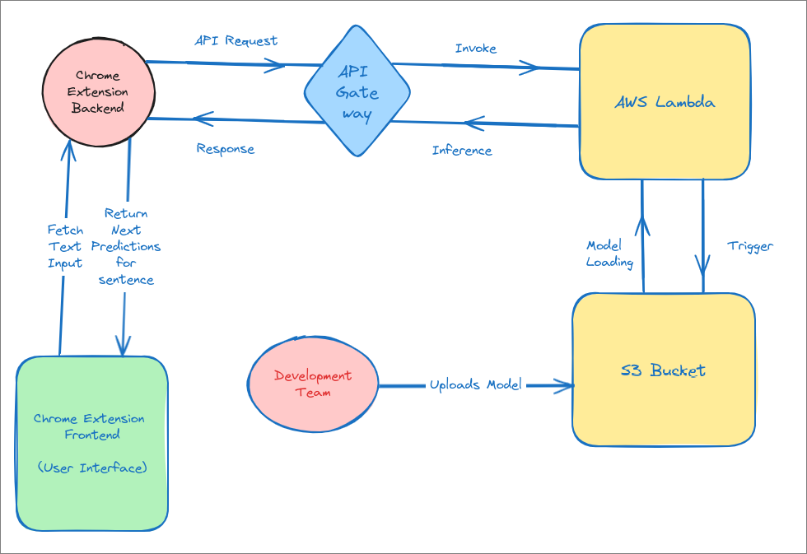
Final proposal for cloud service

Slide 38
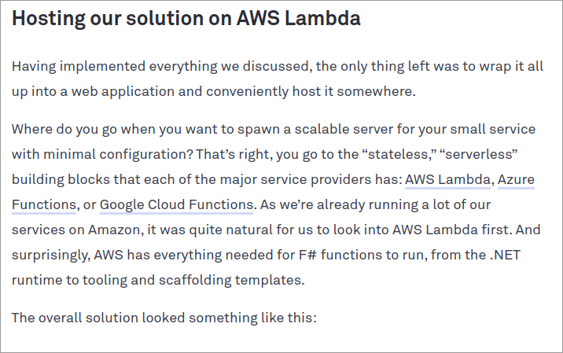
Grammarly talks about lambda

Slide 39
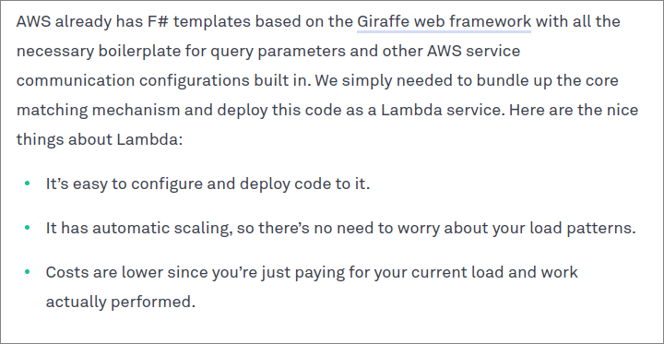
Grammarly talks about lambda

Slide 40
THANK YOU
- Priet, Garvit, Siddharth, shreyansh

